Slide 1

Recursion
“This is the song that never ends! It just goes on and on my friend. One day somebody started singing it not knowing what it was, and they’ll continue singing it forever just because…”
– Lamb Chop

Slide 2
Recursion Theory
Stuff goes here
asdf

Slide 3


What is rECURSION?
Recursion is the repeated application of recursion.
A recursive algorithm references itself as part of the solution:
Fib(0) = 0 Fib(1) = 1 Fib(n) = Fib(n-1) + Fib(n-2) 0, 1, 1, 2, 3, 5, 8, 13, 21…

Slide 4
Recursive Methods
In Java (and most languages), methods can directly invoke themselves by name:
01 02 03 04 05 06 07 08 09 10 11 12 13 14
public static int fibonacci(int n)
{
if (n == 0)
return 0;
if (n == 1)
return 1;
return fibonacci(n – 1) + fibonacci(n – 2);
}
public static void main(String[] args)
{
System.out.println(fibbonaci(3));
}
STACK
main()
args = []
2
fibonacci()
n = 3
1 +
1
fibonacci()
n = 1
fibonacci()
n = 2
1 +
0
fibonacci()
n = 0
fibonacci()
n = 1
Output
2

Slide 5
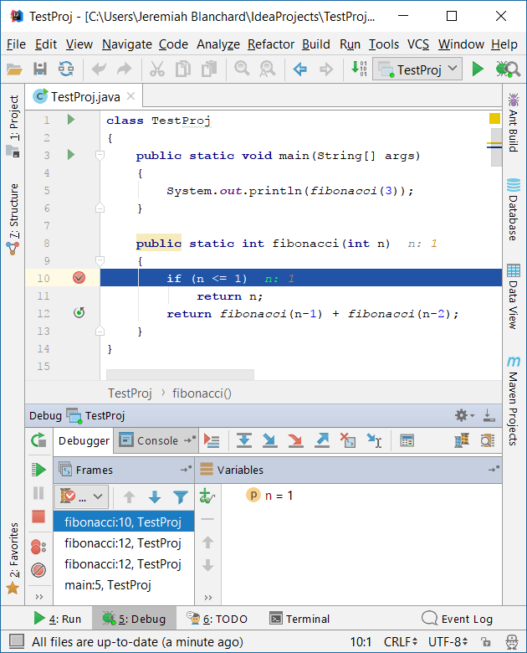
Debugging in Recursion
When debugging in recursive algorithms, keep your place!
01 02 03 04 05 06 07 08 09 10 11 12 13
public static int fibonacci(int n)
{
System.out.println("Computing fib. " + n + "\n");
if (n <= 1)
return n;
return fibonacci(n – 1) + fibonacci(n – 2);
}
public static void main(String[] args)
{
System.out.println("Result is " + fibbonaci(3));
}
Output
Computing fib. 3
Computing fib. 2
Computing fib. 1
Computing fib. 0
Computing fib. 1
Return is 3

Slide 6
Stack Overflow
It’s not just a place to find code snippets!
Recursion makes liberal use of the stack
Most of the time this is fine
What if we go too deep?
STACK
main()
args = []
badIdea()
n = 4000000000
badIdea()
n = 3999999999
01 02 03 04 05 06 07 08 09 10 11 12
public static int badIdea(int n)
{
if (n <= 1)
return n;
return badIdea(n – 1) + 1;
}
public static void main(String[] args)
{
System.out.println(badIdea(4000000000));
}
badIdea()
n = 3999999998
badIdea()
n = 3999999997
badIdea()
n = 3999999996
…
No mem for you

